Slide 1
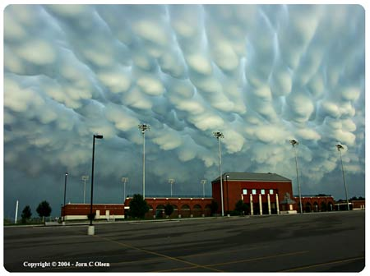
Intro to Meteorology
Why study Meteorology?
What if you saw this at your High School? ->

Slide 2
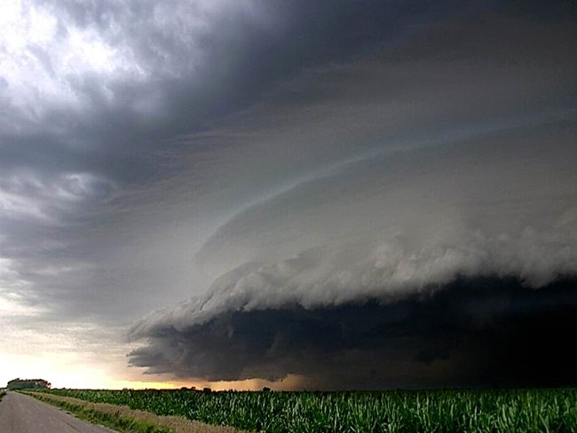
Or this outside your house?
->
Would you know what was going on?

Slide 3
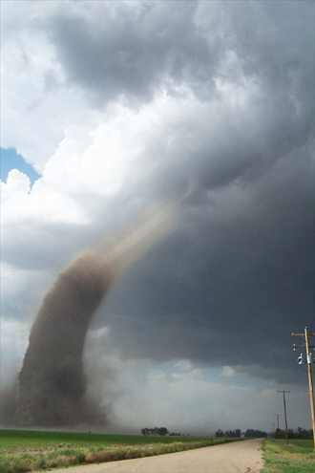
Would you know what to do in this event?

Slide 4
Atmosphere Basics

Slide 5
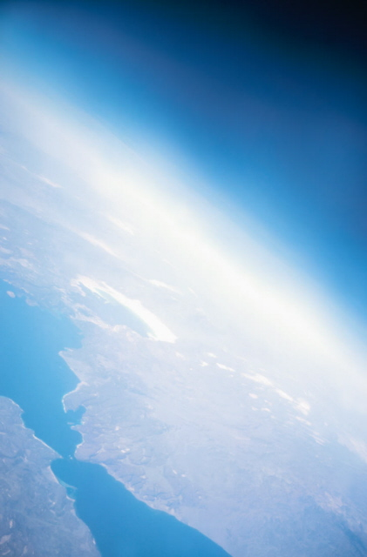
Why study the atmosphere?
The atmosphere is essential to all life on Earth.
Weather- based on day-to-day observations made for a region
Climate- based on observations made for a region over several years

Slide 6
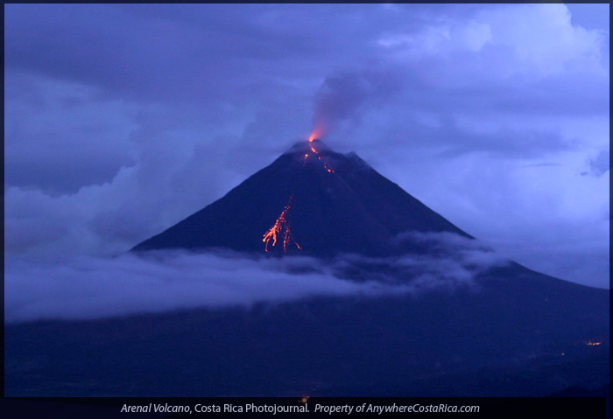
Atmosphere Beginnings
Where did we get the gases for our atmosphere?
Volcanic activity releases gases from inside Earth, heavy gases are pulled by gravity creating atmosphere

Slide 7
Atmosphere Components
99 % of atmosphere is made of 2 elements
78% Nitrogen – largest component of atmosphere!
21% Oxygen
1% CO2, Argon, others
Water Vapor - Amount of water in the atmosphere
Changes, depends on where air originated
Dry air- originated over land
Moist air- originated over water

Slide 8
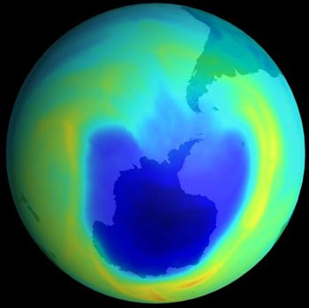
Ozone Layer
Ozone = O3
Form of oxygen that combines 3 oxygen atoms into each molecule
Absorbs radiation that helps block out some of the harmful UV rays emitted by sun.
Being damaged by CFC’s

Slide 9
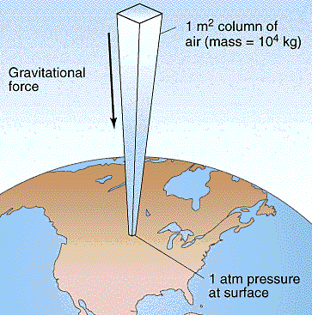
Atmospheric Pressure
As you move through the atmosphere you will experience a gradual change in pressure
Atmos. Pressure- the weight of the air above you
Pressure slowly decreases the farther you go up

Slide 10
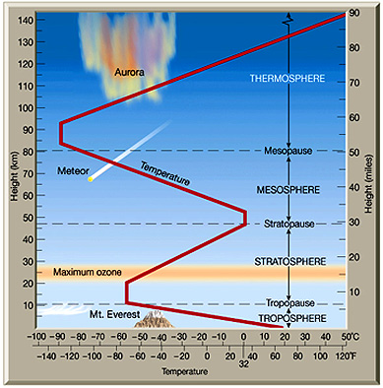
Atmospheric Layers
4 Layers
99% of Earth’s atmosphere is within 30 km of Earth’s surface.
Changes in temperature separate the layers

Slide 11
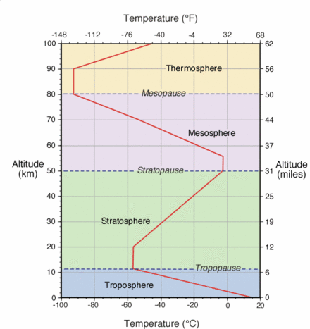
Troposphere
Lowest layer of the atmosphere
Temperature decreases with increasing altitude
Includes all weather, clouds, and thunderstorms
Tropopause - boundary between the troposphere and the stratosphere

Slide 12
Stratosphere
Second layer of the atmosphere
Temperature increases with increasing altitude
This temperature increase is due to the ozone layer
Stratopause – boundary between the stratosphere and the mesosphere

Slide 13
Mesosphere
Third layer of the atmosphere
Temperature decreases with increasing altitude
Coldest layer
Mesopause – boundary between the mesosphere and the thermosphere

Slide 14
Thermosphere
Fourth and outermost layer of the atmosphere
Subdivided into the exosphere and the ionosphere
Temperature increases with increasing altitude
Extremely high temperatures due to solar radiation

