Slide 1
Air Masses and Fronts

Slide 2
Wind
Wind is the movement of air from places of high pressure to places of low pressure
Wind moves in large masses called air masses
Air masses also move from areas of high pressure to areas of low pressure
These air masses retain the characteristics of where they form

Slide 3
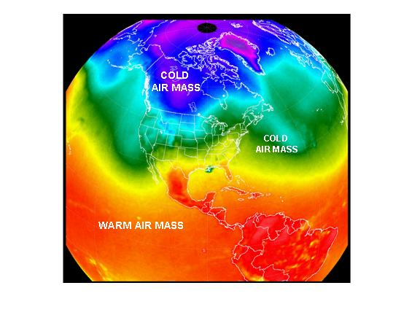

Slide 4
Types of Air Masses
Air masses can be described in two ways
Moisture
Continental (dry air) vs. Maritime ( moist air)
Depending on if the air mass forms over land or water depends on if it carries a lot of moisture
Temperature
Tropical (warm air) vs. Polar (cold air) vs. Arctic (coldest air)
The temperature of the air mass depends on if it formed closer to the equator or closer to the poles

Slide 5
Putting it all together
 | Continental | Maritime
Tropical | Continental Tropical: cT | Maritime Tropical: mT
Polar | Continental Polar: cP | Maritime Polar: mP
Arctic | Continental Arctic: cA
Knowing moisture and temperature, what would the characteristics be of…
Continental Polar (cP)?
Maritime Tropical (mT)?
Continental Arctic (cA)?

Slide 6
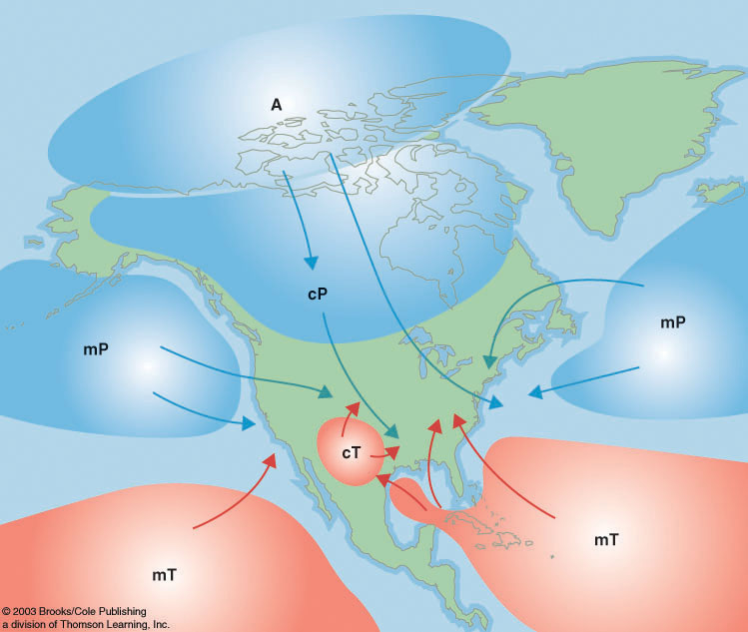
Notes:
MAKE SURE YOU TALK ABOUT THESE! MUST BE ABLE TO IDENTIFY THAT SOUTH EASTERN STATES ARE GETTING AIR MASS mT ON A MAP!

Slide 7
Fronts
Front – the boundary between two different air masses
Along a front, warmer, less dense air is always forced upwards
4 types of fronts
Warm
Cold
Stationary
Occluded

Slide 8
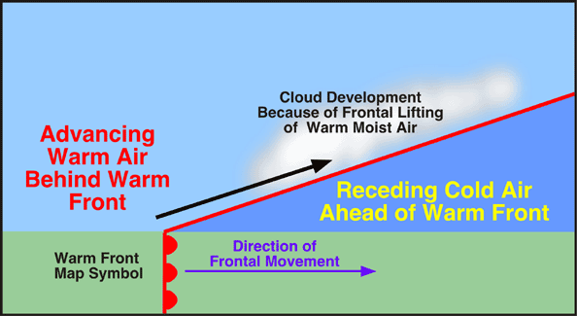
Warm Front
A warm front occurs when warm air slowly moves into an area covered by cooler air.
Takes a long time for warm air to displace colder air
Marked by long and steady rain
Red semi-circles are symbols for warm front

Slide 9
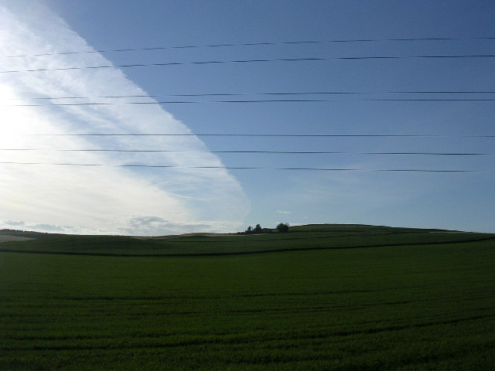

Slide 10
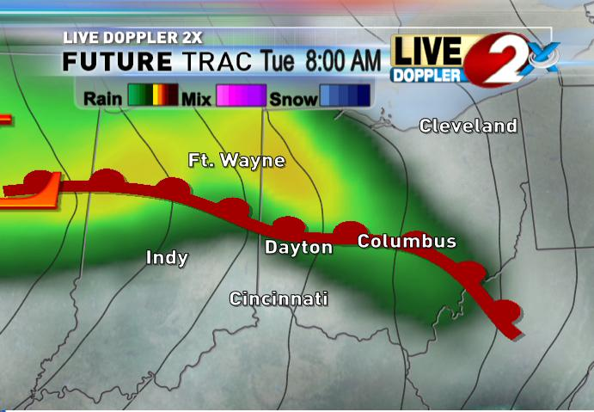

Slide 11
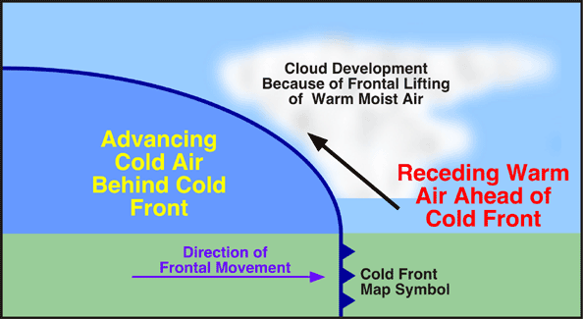
Cold Front
A cold front forms when cold, dense air quickly moves into an area occupied by warm air
Compared to speed of warm front, cold fronts move very fast
Marked by heavy precipitation/thunderstorms for a short period of time
Blue triangles are symbols for cold front

Slide 12
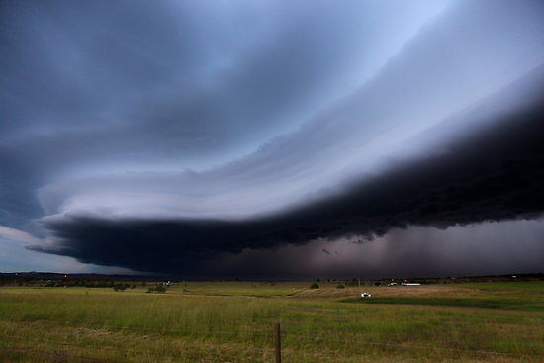

Slide 13
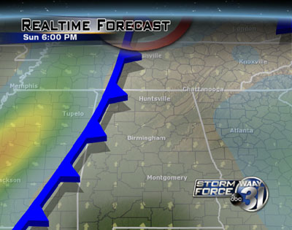

Slide 14
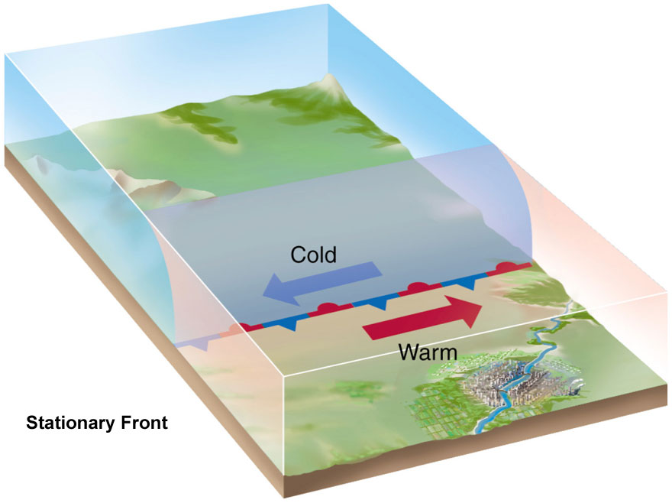
Stationary Front
If fronts are not moving towards each other, but rather moving parallel a stationary front occurs.
Mild precipitation can occur on a stationary front
Red semi-circles on one side, blue triangles on other

Slide 15
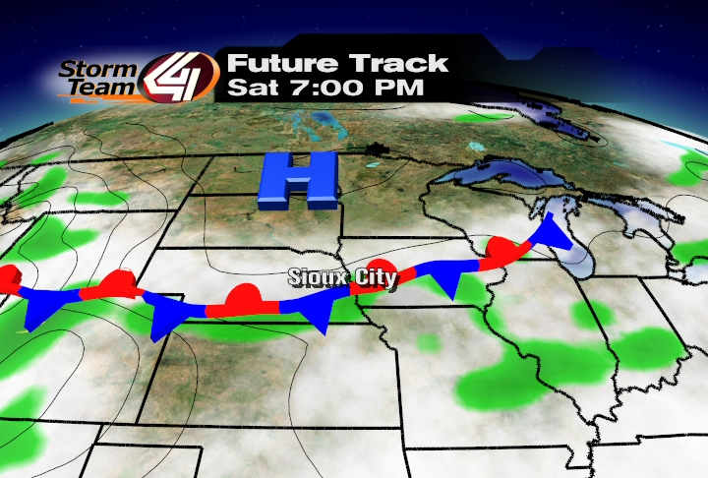

Slide 16
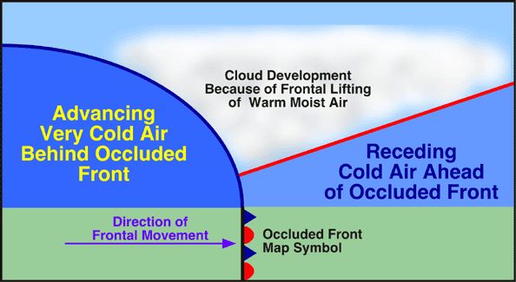
Occluded Front
Cold fronts move faster than warm fronts
When an active cold front overtakes a warm front, an occluded front forms
This will force the warm front up into the air, which will lead to heavy rain
Usually marked by purple semi-circle and triangles in same direction

Slide 17
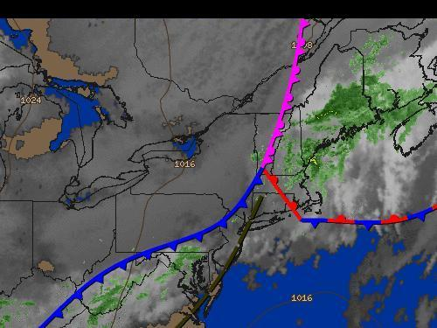

Slide 18
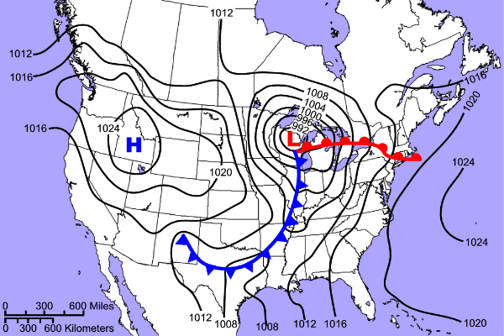
What air masses can be found moving in at each orange arrow?
What is the weather like at the H and L?

