Slide 1
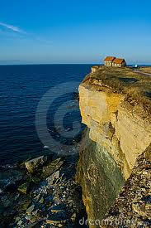
Science Starter
Imagine you lived in this house on the edge of a cliff
What would some concerns be about living there?
What potential dangers might you face? Explain how these dangers may occur.

Slide 2
Weathering Review
Increased surface area = increased (faster) rate of weathering (Gobstopper Experiment)
Wet & Warm climate = fastest rate of weathering
            Alka-seltzer dissolved fastest in warm H2O
Physical (Mechanical) Weathering-like tearing a paper
Chemical Weathering-like burning a paper

Slide 3
Agenda
Warm-Up
Weathering Review
Global Focus: Uganda
Erosion Lab
Erosion Notes
Erosion Video
Exit Ticket

Slide 4
Daily Goal
SWBAT compare erosion by water, wind, ice, and gravity and the effect on various landforms
Key Terms: erosion, deposition, gravity

Slide 5
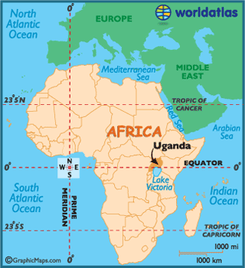
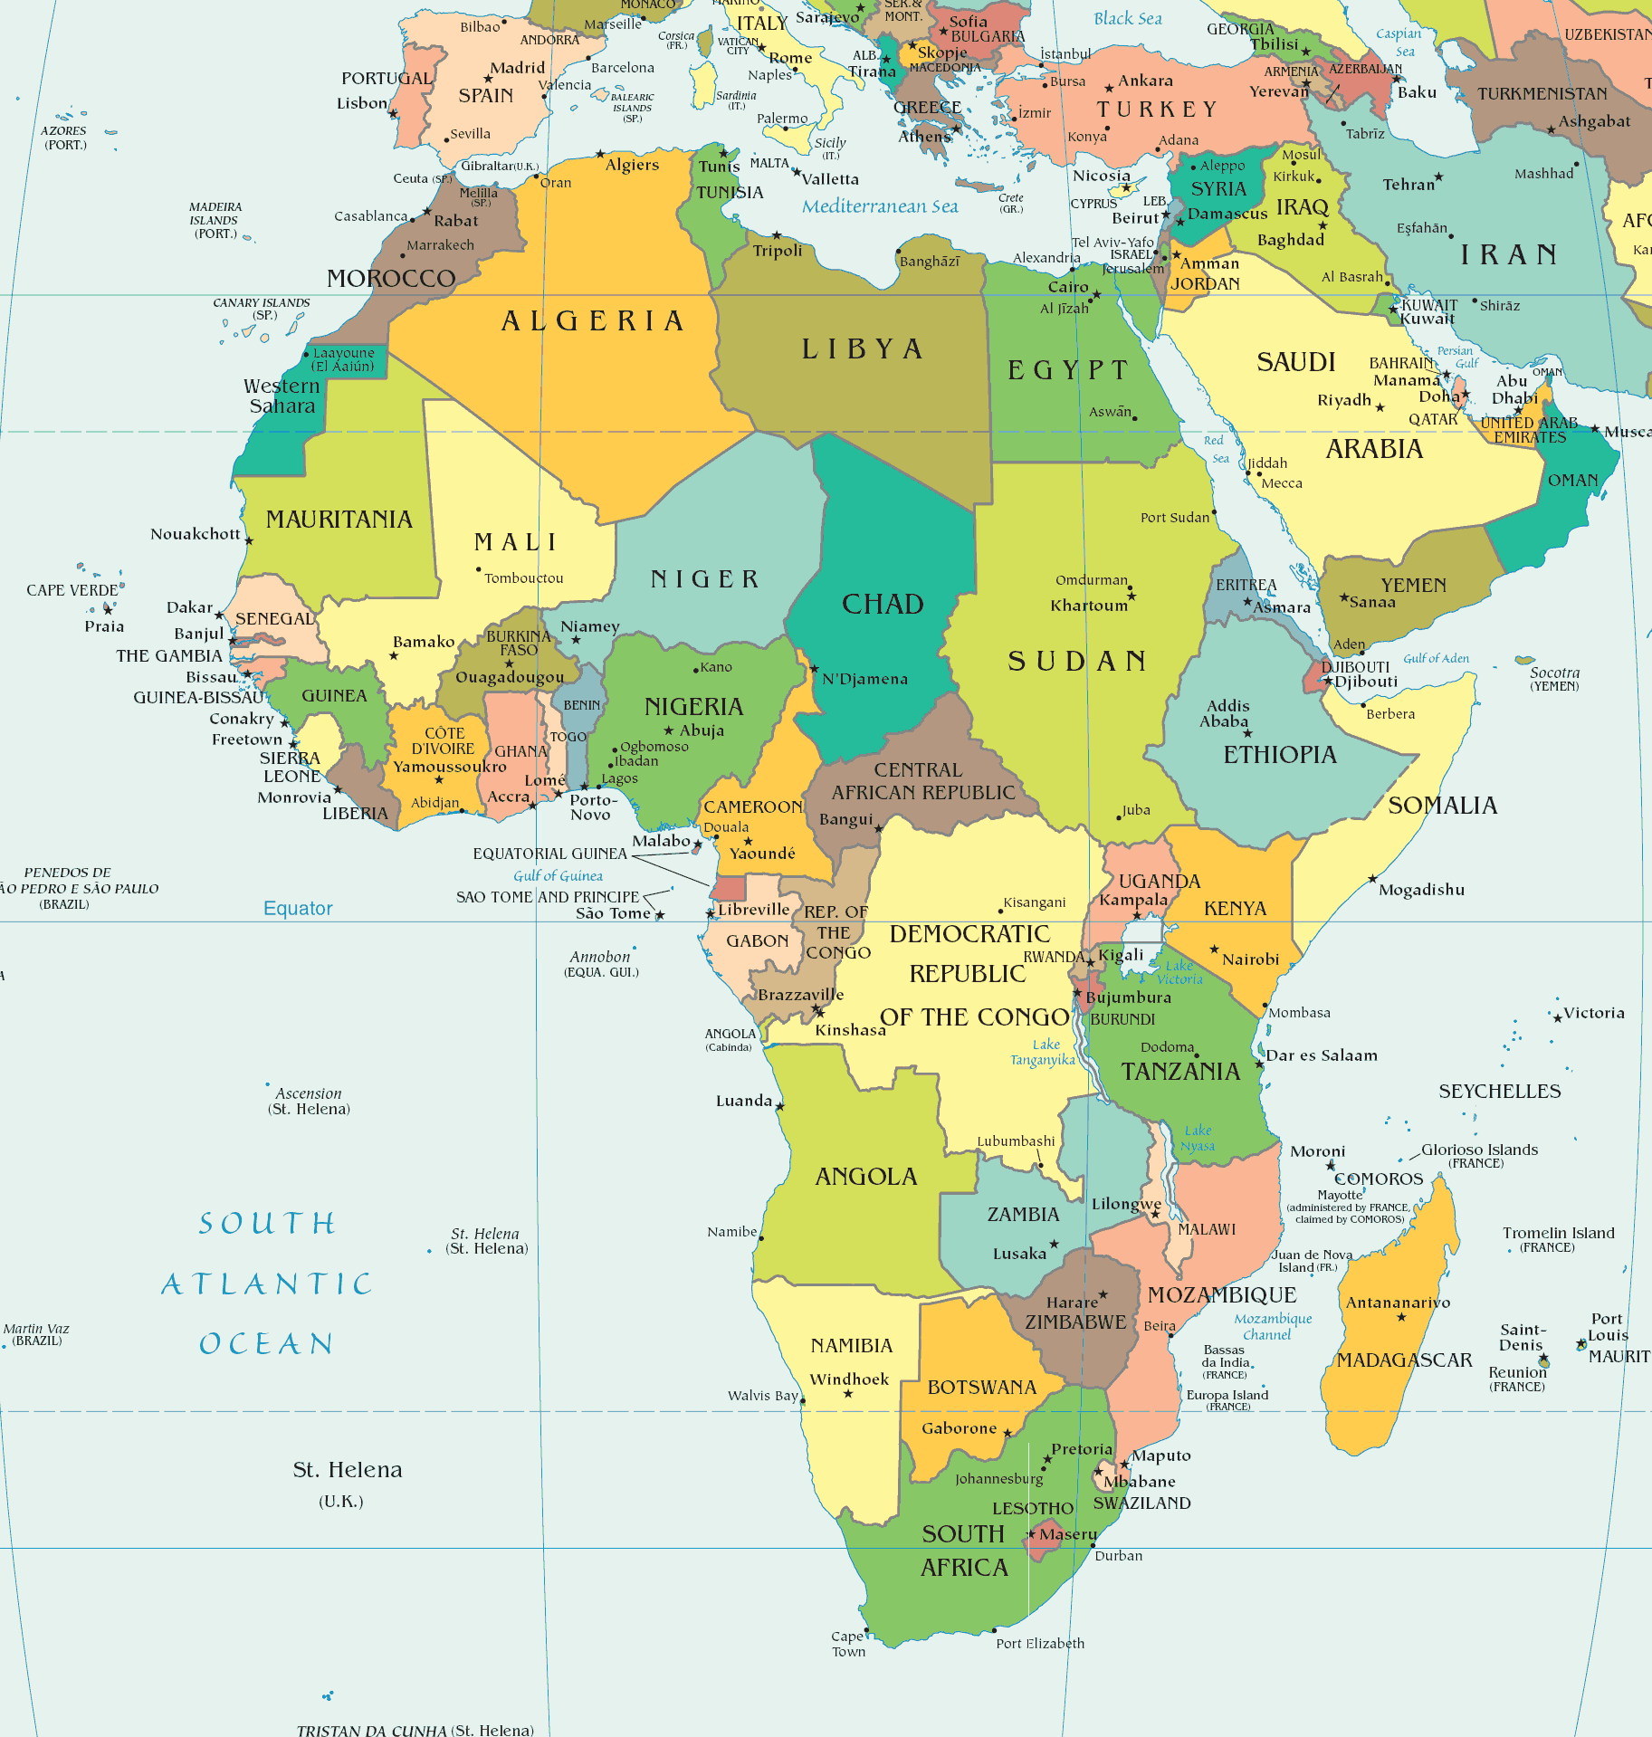
Uganda

Slide 6
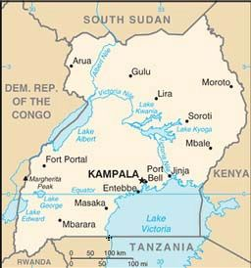
Facts about Uganda
Capital: Kampala
Climate: Tropical
Population: 32.7 million
Languages: English & Swahili (official); numerous other local tribal languages
Education: 56% finish Primary school; 74% literate
Life expectancy: 52.7 years old
http://vimeo.com/5438151
Notes:
http://www.youtube.com/watch?v=IviDA-2DLUM

Slide 7
Landslide Kills at Least 29
A landslide killed at least 29 people on Monday, August 30, 2011 in an eastern district of Uganda, including children buried in their homes, officials said. The bodies of 6 children and 13 others had been found, the Red Cross said, and the government said it had sent crews to help recover any remaining victims. The landslides occurred after heavy rainfall in the Bulambuli district, 167 miles east of Kampala

Slide 8
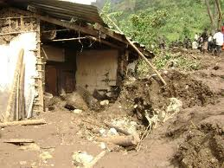
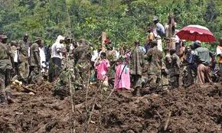
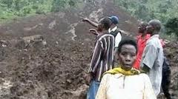
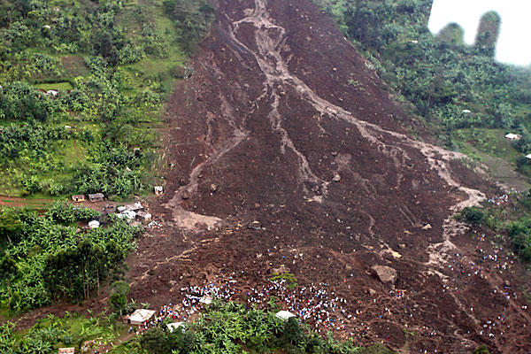
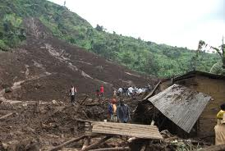

Slide 9
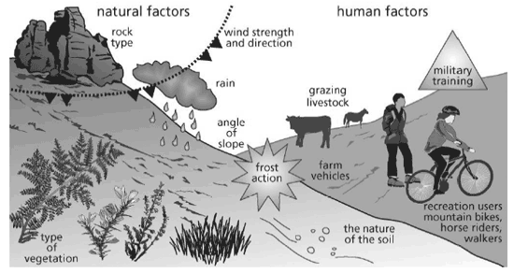
Erosion: A Destructive Natural Force

Slide 10
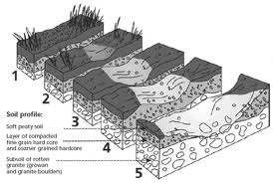
What is Erosion?
The transportation of material by wind, water, ice, or gravity on the Earth’s surface.

Slide 11
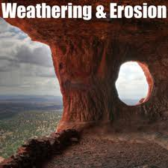
How does erosion differ from weathering?
Weathering BREAKS DOWN the Earth’s material into sediments.
Erosion TRANSPORTS the sediments to a new location.

Slide 12
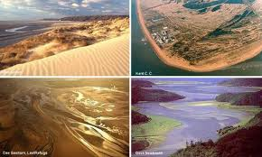
After the material is eroded, where does it go?
Deposition is the process by which sediments are dropped in a new location, building up and creating a new landform over time.
Erosion transports materials from place to place. Deposition drops sediments and builds new landforms.

Slide 13
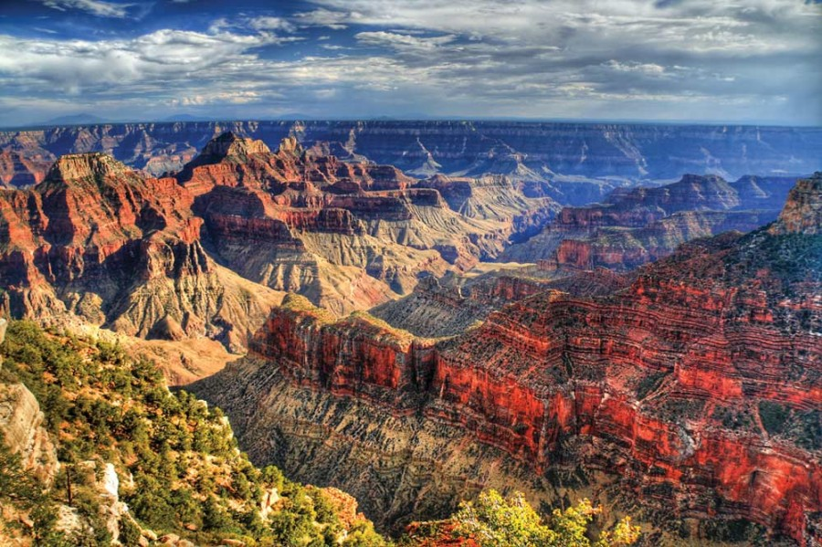
How did the Grand Canyon form?
The Grand Canyon took 3-6 million years to form
Millions of years ago, the Colorado River flowed slowly across a broad flat area in present day Arizona. Over time, the Grand Canyon was carved into the Earth through erosion by the Colorado River.

Slide 14
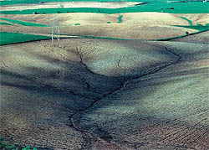
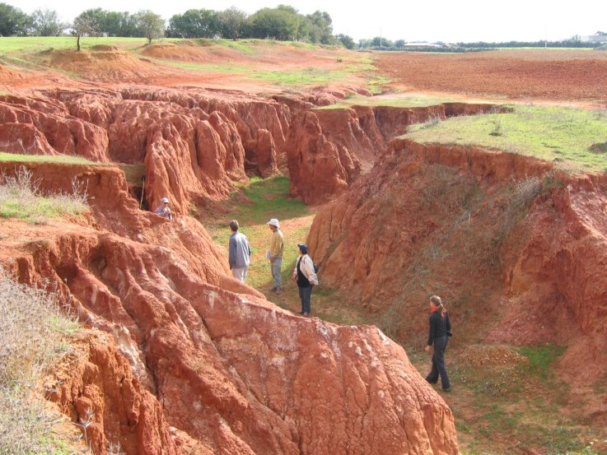
How does Water cause erosion?
Stream Erosion: As water in a stream moves along, it picks up sediments from the bottom and sides of its channel.
Gullies form on hillsides when run-off cuts into the soil. They resemble large ditches or small valleys.
Running water is the primary cause of erosion all over the world, primarily due to water flowing over the land as runoff or hitting coasts and beaches.

Slide 15
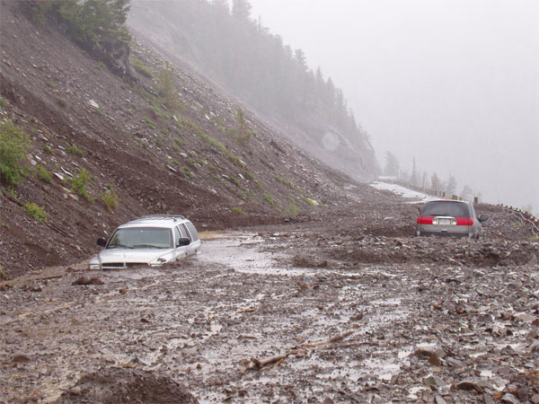
How does Gravity cause erosion?
Mass Wasting: the movement of rocks and sediments downhill because of gravity.
  Slump: downward movement of material along a curved surface.
  Creep: slow downward movement of sediments

Slide 16
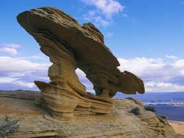
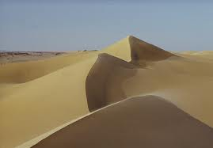
How does Wind cause erosion?
Wind is the most active agent of erosion in deserts, in plowed fields, and on beaches.
Deflation is the lifting and removal of loose particles such as clay and silt, resulting in the lowering of the land surface
Sand dunes form as a result of wind erosion in the desert

Slide 17
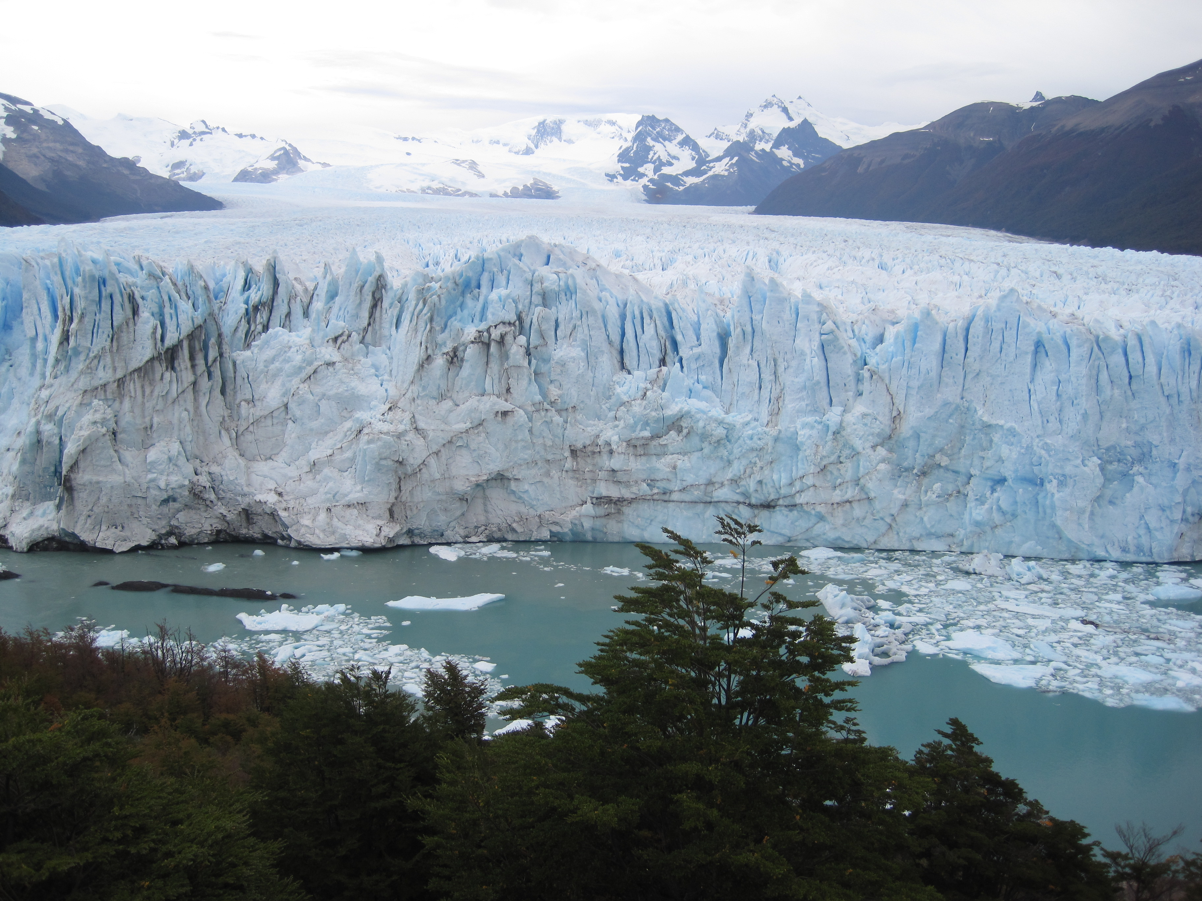
How does Ice cause erosion?
Glaciers are huge masses of moving ice that erode by mainly two different processes: Abrasion and Plucking.
Abrasion: glacial ice and rock fragments smooth and polish the bedrock surface like sandpaper.
Plucking: rock breaks up beneath the glacier when the melted water gets into the cracks and refreezes (*like frost wedging). The broken fragments are picked up and incorporated into the glacier.

Slide 18
Let’s take a closer look…

Slide 19
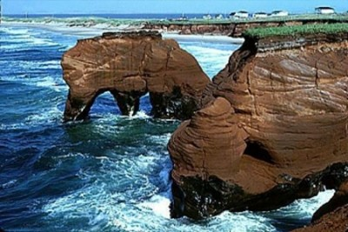
Erosion can occur because of…
Wind
Water
Ice
Gravity

Slide 20
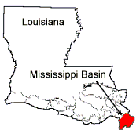
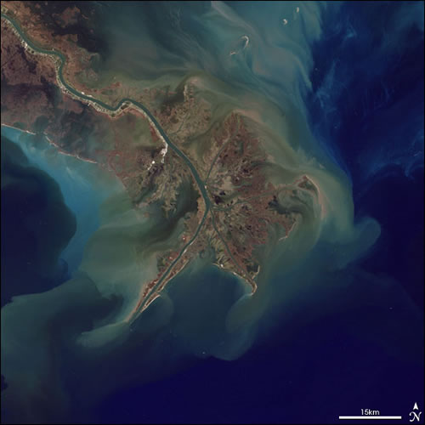
Where can erosion be seen in real life?
The entire river basin in Louisiana is the product of sediment deposition from the Mississippi River following the latest rise in sea level about 5,000 years ago.

Slide 21
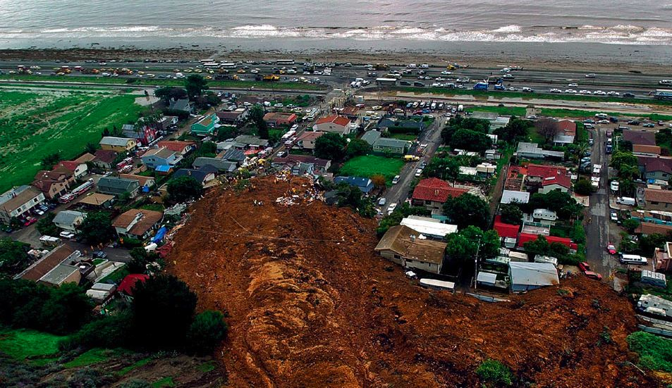
Mudslide

Slide 22
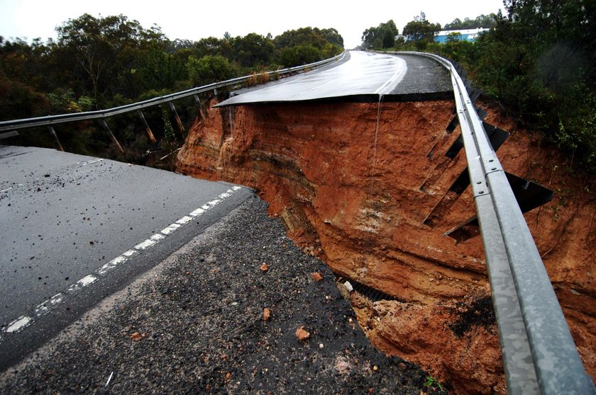
Water
Flooding

Slide 23
Wind

Slide 24
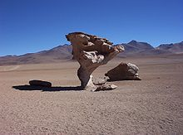
Arbol de Piedra in Altiplano, Bolivia

Slide 25
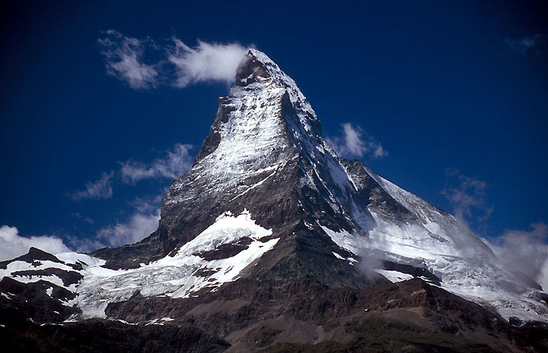
Ice
The Matterhorn, the border of Switzerland and Italy

Slide 26
Gravity
Mudslide

Slide 27
Erosion Video
http://www.brainpop.com/science/earthsystem/erosion/preview.weml

Slide 28
Extension Activity
How do weathering, erosion, and deposition form a continuous cycle that builds-up and breaks down the land over time? (Develop a diagram or picture to show this and support your answer)

Slide 29
Quick Check!
What are the 4 types of erosion?
Name one example for each four types.

Slide 31
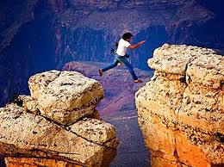
Exit Ticket
What is the major role of erosion?
What are the major differences between each type of erosion.
The Grand Canyon was formed by which type of erosion?

