Slide 1
DO NOW
What are three main types of SOIL?
What is Humus? What are 4 components that make up SOIL?
Give a short description for each:
Sedimentary:______________________________
Igneous: _________________________________
Metamorphic:_____________________________
List 3 types of mechanical weathering and

Slide 2
Objective
Objective: Summarize the major events in the geologic history of North Carolina.

Slide 3
Essential Question
How has the land in NC changed over time?

Slide 4
By the end of today’s lesson you will be able to correctly answer the following question:
What caused mountain ranges to form in the western part of North Carolina?
the opening of the Atlantic Ocean as plates separated
the collision of the African plate and North American plate
the separation of the African plate and North American plate
the subduction of the Atlantic Ocean as it collided with North America
Notes:
Teacher Actions: Use quick quiz strategy.
Assessment (i.e. SAT or ACT practice, Writing: RACE+C)
NY Regents
3. Energy is produced within the Sun’s core by the process of
insolation
nuclear fusion
conduction
radioactive decay

Slide 5
In a 4 minimum lines, Describe the geosphere in North Carolina. Use the following questions to guide your response:
What does the soil look and feel like?
Is the land flat, or is it hilly? Are there mountains?
Does it all look the same? In what parts of NC does the land look different than it does in Charlotte?
Where do you find water in NC?
Notes:
Teacher Actions: Have student read prompt aloud and answer any clarifying questions students may have.
Student Actions:
Students should respond to questions in their notebooks.

Slide 6
Visit North Carolina
Governor McCrory wants to bring more tourists to North Carolina
He thinks that if tourists know about NC’s history, they will want to visit
We are going to use our knowledge of NC’s geologic history to make a tourist brochure!

Slide 7
Lesson Learning Strategy
Fold your paper along the lines.
No more than 3 people at a station.
Volume= Quiet
Copy down all the information on the slides.
Make sure to label figures when necessary.
If you finish early, decorate the front of your brochure!

Slide 8
North Carolina’s 3 Regions
NC is divided into 3 regions based on landforms and topography
Coastal Plain
Flat, poorly drained area of estuaries, swamps, and beaches
Piedmont
Broad plateau with gently rolling hills and low mountains
Blue Ridge Mountains
String of mountains that dominate western 1/3 of NC

Slide 9
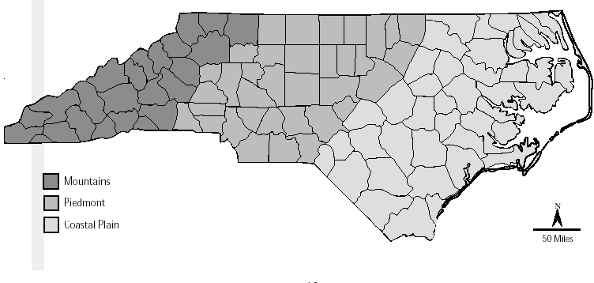
Figure 1: NC’s 3 Regions
High elevation
Mid elevation
Low elevation

Slide 10
Blue Ridge Mountains
450 million years ago, the African continental plate and the North American continental plate collided
This collision forced part of a plate fragment up and over rocks, creating the Blue Ridge Mountains

Slide 11
Appalachian Mountains
250 million years ago, Africa and North America collided to form the supercontinent Pangaea
Over millions of years, the compression caused folding of rock, creating the Appalachian Mountains
The Appalachians are wider and higher in NC than in any other state

Slide 12
Coastal Plain
200 million years ago, Africa and North America began to split apart
The Atlantic Ocean formed.
Rivers carried sediment from the mountains, which helped form the Coastal Plain

Slide 13
The Piedmont
400 million years ago, Africa and North America were still moving closer together.
Parts of the sea floor and a group of volcanic islands also collided with North America.
They formed the base of the Piedmont.

Slide 14
Fall Line
The fall line is a zone that forms the border between the Coastal Plain and the Piedmont.
Many towns in NC, like Raleigh, grew on the fall line to serve trade lines coming in from the coast

Slide 15
Barrier Islands
NC’s coast is a broad lowland with a string of narrow, sandy barrier islands that parallel the shoreline
These islands, known as the Outer Banks, protect shallow bays and wetlands on the mainland behind them
The islands formed thousands of years ago, when sea level rose after the last ice age

Slide 16
River Basins
North Carolina has plentiful surface and underground freshwater supplies
The state has 12,200 km of rivers and streams in 18 major river basins
The drainage basin of the Catawba river supplies drinking water for Charlotte

Slide 17
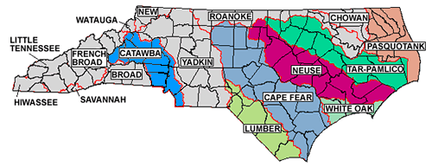
Figure 2: NC River Basins

Slide 18
Sketch a billboard encouraging tourists to visit North Carolina.
Your billboard should include:
A slogan
2 “sites” to see (2 places to visit that you learned about in the brochure)
A picture or graphic in color!
Notes:
Teacher Actions: Have students read instructions aloud
Student Actions: Students create billboard in their notebook.

Slide 19
North Carolina’s geosphere has changed over time
These changes were caused by the movements of tectonic plates millions of years ago
These movements have shaped the land, which provides NC regions with unique resources and climates
Notes:
Teacher Actions: Cold call students to read bullet points.

Slide 20
By the end of today’s lesson you will be able to correctly answer the following question:
What caused mountain ranges to form in the western part of North Carolina?
the opening of the Atlantic Ocean as plates separated
the collision of the African plate and North American plate
the separation of the African plate and North American plate
the subduction of the Atlantic Ocean as it collided with North America
Notes:
Teacher Actions: Use quick quiz strategy.
Assessment (i.e. SAT or ACT practice, Writing: RACE+C)
NY Regents
3. Energy is produced within the Sun’s core by the process of
insolation
nuclear fusion
conduction
radioactive decay

Slide 21
By the end of today’s lesson you will be able to correctly answer the following question:
What caused mountain ranges to form in the western part of North Carolina?
the opening of the Atlantic Ocean as plates separated
the collision of the African plate and North American plate
the separation of the African plate and North American plate
the subduction of the Atlantic Ocean as it collided with North America
Notes:
Teacher Actions: Use quick quiz strategy.
Assessment (i.e. SAT or ACT practice, Writing: RACE+C)
NY Regents
3. Energy is produced within the Sun’s core by the process of
insolation
nuclear fusion
conduction
radioactive decay

Slide 22
UNIT 3 TEST TUESDAY

